Slide 1
CP1406 – Week 1
Intro to the Internet and Web Design

Slide 2
Subject Learning Outcomes
apply user-centred design principles and methods;
demonstrate best practices in creating standards-based websites;
apply HTML, CSS and JavaScript to develop interactive websites
Notes:
Discuss each of these

Slide 3
Assessment Items – CP1406
Website development Part 1 - (30%) - Individual
Website development Part 2 - (40%) - Individual
Practical assessment/practical skills demonstration - (30%) - Individual

Slide 4
Assessment Items – CP5638
Website development Part 1 - (20%) - Individual
Website development Part 2 - (35%) - Individual
Practical assessment/practical skills demonstration - (20%) - Individual
Research report - (25%) - Individual

Slide 5
Learning in This Subject
Lectures: video recordings AND interactive sessions
Practicals: practising skills and making websites
Subject outline: get this from LearnJCU​ and read it
Slack: #cp1406​

Slide 6

Use online (code) resources appropriately
You must do the main things yourself – HTML & CSS
You cannot use existing CMS software like WordPress
You can use JavaScript libraries (like jQuery, image galleries…) for "extras" but not for the core functionality
You may appropriately use parts of templates and examples, but you need to make them fit your design, not the other way around
It's OK to find existing sites, copy them to see how the code works, then repurpose parts of them for your site – but no direct copying
Frameworks like Bootstrap are great, but not allowed for this subject
If in doubt, please talk to your lecturer about what is appropriate
Notes:
We're trying to find a god balance of learning the basics (HTML, CSS, JS) from the ground up and leveraging existing technologies to improve our sites and reduce development time. Many professionals use existing CMSs, templates and frameworks – but they usually learned the basics first, and understand how these things work.

Slide 7
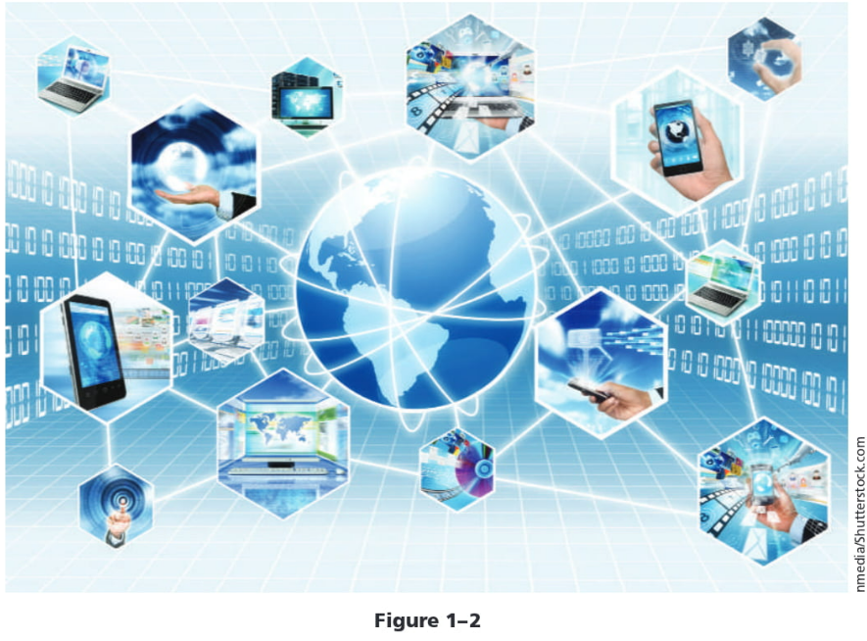
Exploring the Internet
The Internet is a worldwide collection of computers
Data lines that connect networks allow data to move from one computer to another
Millions of people worldwide have access to the Internet
Notes:
Linked together for use by organisations, and individuals using communications devices and media
A node is any device, such as a computer, tablet, or smartphone, connected to a network
A network is a collection of two or more computers linked together to share resources and information
The Internet of Things describes the ever-growing number of devices connecting to a network, including televisions and appliances

Slide 8
World Wide Web
The World Wide Web, also called the web, is the service that provides access to information stored on web servers
The web consists of a collection of linked files known as webpages
A website is a related collection of webpages created and maintained by a person, company, educational institution, or other organisation

Slide 9
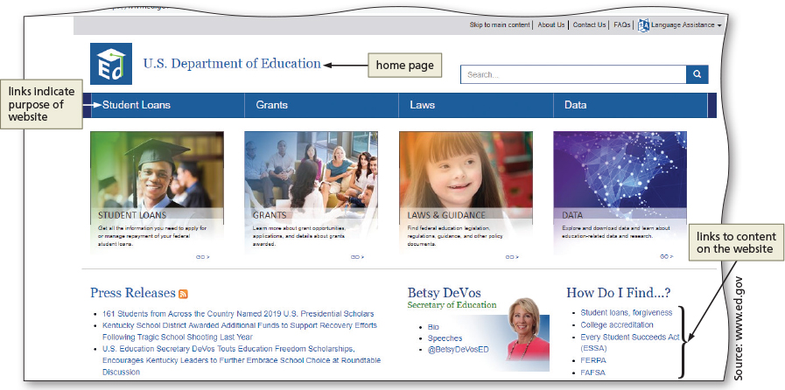
World Wide Web
A home page is the first document users see when they access a website
A hyperlink, commonly called a link, is an element that connects one webpage to another webpage on the same server or to any other web server in the world

Slide 10
Protocols
Set of rules or standards that define how something operates
Protocols exist for how a client device communicates with a server
Internet Protocol (IP) ensures data is sent to the correct location
The Domain Name System (DNS) associates an IP address with a domain name

Slide 11
Protocols
A server is the host computer that stores resources and files for websites
Hypertext Transfer Protocol (HTTP) is a set of rules for exchanging text, graphics, audio, video, and other multimedia files on the web
File Transfer Protocol (FTP) is used to exchange files from one computer to another over the Internet
Does not provide a way to view a webpage

Slide 12
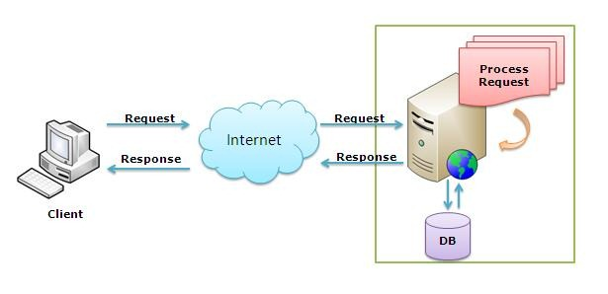
Client-server architecture
HTTP Request-Response Cycle
Client requests page via URL
DNS lookup converts URL to IP address
Server processes request, which may involve running code and accessing databases, then returns results to client
Client displays results in browser

Slide 13
Client-side vs. Server-side
Front-end / Client-side
HTML – markup language for structuring content
CSS – style language for styling structured content
JavaScript – programming code to provide functionality
The browser runs the JavaScript and renders the HTML+CSS
Back-end / Server-side
PHP – common (Web) programming language
Database (MySQL, SQLite, MongoDB…)
many other technologies and languages can be used on Web servers - node.js, ASP.NET, Go, Ruby, Python, Java Servlets…

Slide 14
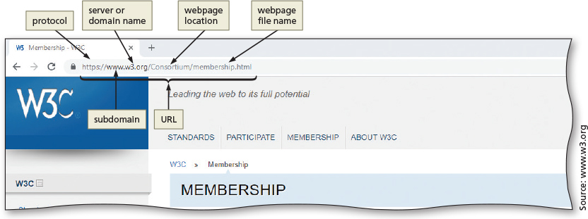
Web Browsers
Interpret and display webpages and enable you to view and interact with a webpage
Google Chrome, Mozilla Firefox, Apple Safari, Microsoft Edge, Opera
A Uniform Resource Locator (URL) is the address of a document or other file accessible on the Internet
Such as https://www.w3.org

Slide 15
Planning a Website
Purpose of the website
Target audience
Multiplatform display
Notes:
Purpose of the website
The purpose of a commercial business website is related to the goal of selling products or services
Target audience
The people who use the website
Knowing their general demographic background will help to design a website appropriate for them
Multiplatform display
A responsive design of a website must be created that provides an optimal viewing experience across a range of devices

Slide 16
Good websites are goal-driven
"does the site serve its purpose well?"
"does it achieve what the client wanted (what they paid for)?"
Clients don't pay for a website, but for what the site can do for them.
So you need to ask that question up front ("what's the goal?") and keep it in mind right through the process.

Slide 17
Why? What's the point of knowing the goal?
Goal
Design & Development
The goal informs the design and the development.
If you can build a site without knowing the goal… you're missing the point! How do you lead users to do whatever the point of the site is?
This includes other planning details like target audience
Notes:
Important! Sites are not just places for content… that content has a purpose – what is it?

Slide 18
Consider these goal examples
A sales site (goal is to sell products), needs to be focused on sales.
That might seem obvious, but some sales sites just present the products… they don't lead people to buy.
An online support site for a company might have the goal of reducing phone calls to customer support (by providing online solutions)…
But if it puts the phone number on the site clearly, people will just keep phoning up.
A community action site (e.g., save the whales) might have the goal to get people to contact their local government…
So, it can be designed to link to the ways to contact government, not just present the issues about the poor whales.
Notes:
What other examples can you think of?

Slide 19
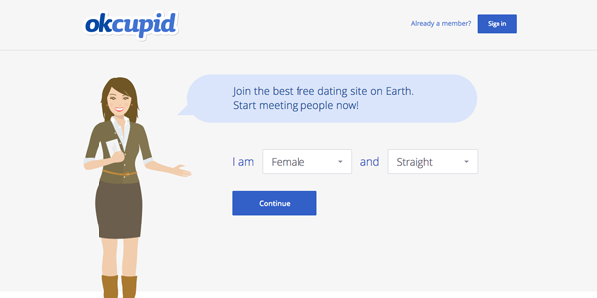
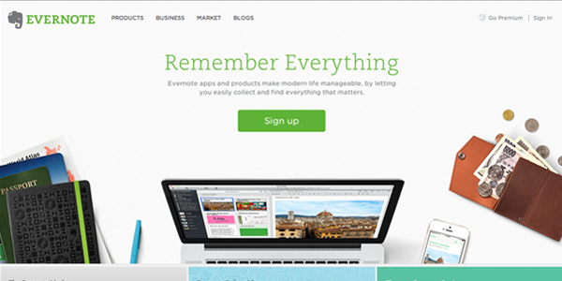
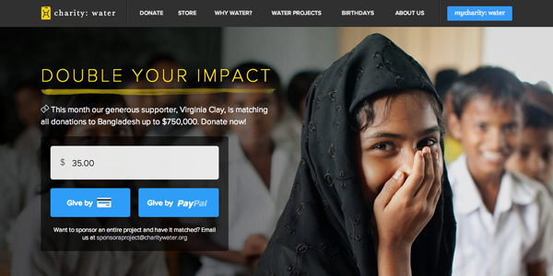
Use calls to action – to lead people
Goal-driven websites lead people to the goal
At the right time and place, there will be a "call to action" (CTA)
Usually very prominent – in the most important screen 'real estate'
Notes:
See http://blog.hubspot.com/marketing/great-call-to-action-examples for more & a free how-to guide.

Slide 20
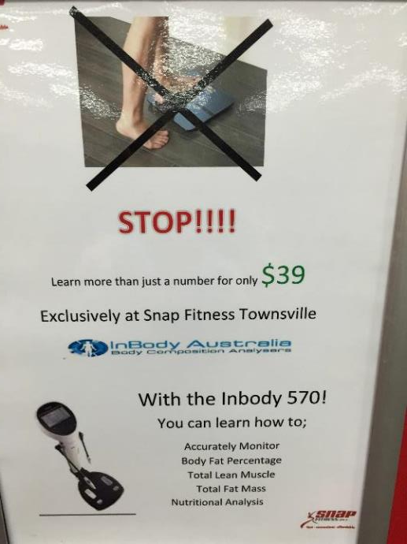
What about this sign?
Notes:
This poster is trying to sell you this service, but how do you buy? Where is the call to action?

Slide 21
YOUR Planning Process
Why
What
How
Goal
Content
Design & Development

Slide 22
A word on "design"
This is not a visual design subject, but we will teach you design principles
There are clear principles for designing sites (and other things), which you can learn
You do not have to be a graphic artist
You will be assessed based on these clear (objective) principles, not on subjective preferences about style
With a little guidance, most people can identify good & bad design

Slide 23
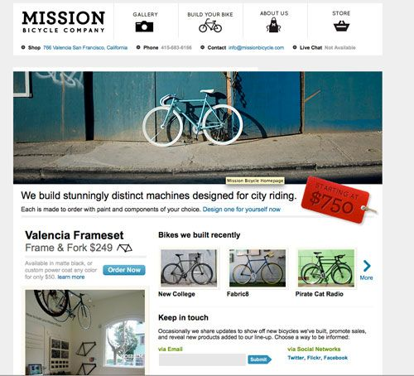
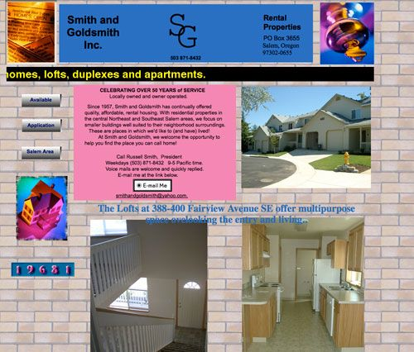
What do you think of these sites?
Notes:
Examples from http://www.swcreatives.com/swc-blog/what_makes_a_good_and_bad_website (read this for a critique)

Slide 24

Design
Designer Luke Wroblewski says visual design can be thought of as two interwoven parts:
Personality/look and feel established by choice of colour(s), typeface(s), textures, images, etc; is rather subjective
Visual hierarchy guides users through content and tells them about the relative importance of and relationships between the elements; is much more objective

Slide 25
Design must facilitate communication by
managing attention
Visual relationships between the elements of the design must reflect their importance and their logical and functional relationships

Slide 26
Wireframe
A simple, visual guide that clearly identifies the location of main webpage elements
Active white space is an area on the page that is intentionally left blank
Helps a user focus on one part of the page
Passive white space is the space between content areas

Slide 27
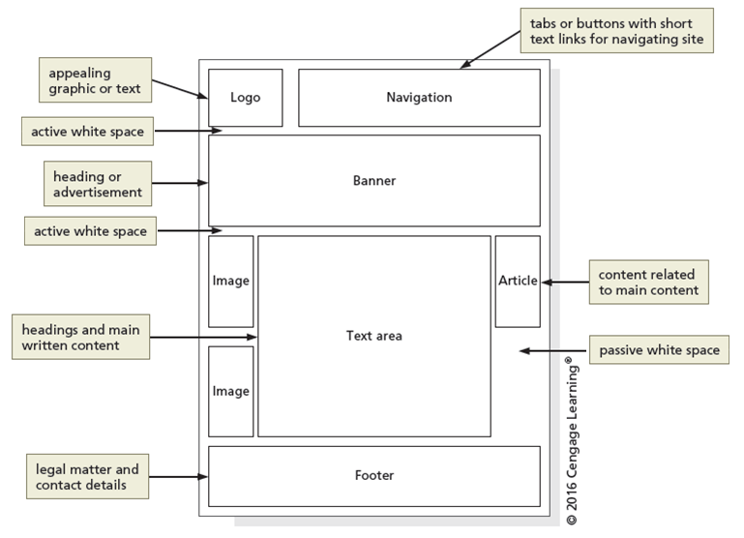
Wireframe
Figure 1-12

Slide 28
Site Map (Information Architecture)
A planning tool that lists or displays all the pages on a website
Indicates how they are related to each other
Shows the structure of a website
A linear website structure connects webpages in a straight line
In a variation of a linear website structure, each page can include a link to the home page of the website
A hierarchical website connects webpages in a treelike structure
A webbed website structure has no set organisation

Slide 29
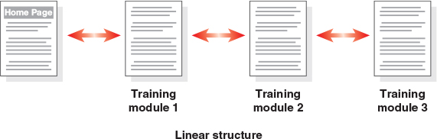
Site Map – Linear Structure
Figure 1-13

Slide 30
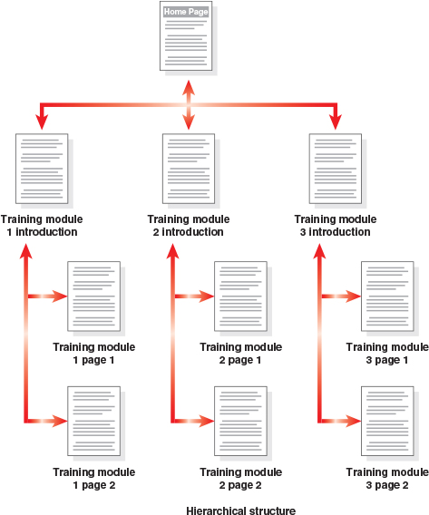
Site Map - Hierarchical Structure
Figure 1-15

Slide 31
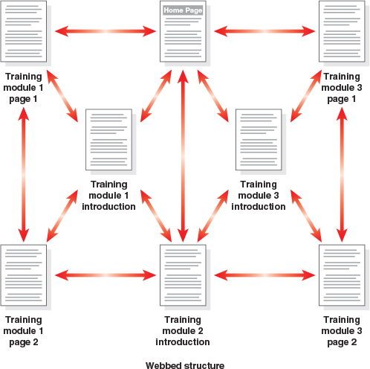
Site Map - Webbed Structure
Figure 1-16

Slide 32
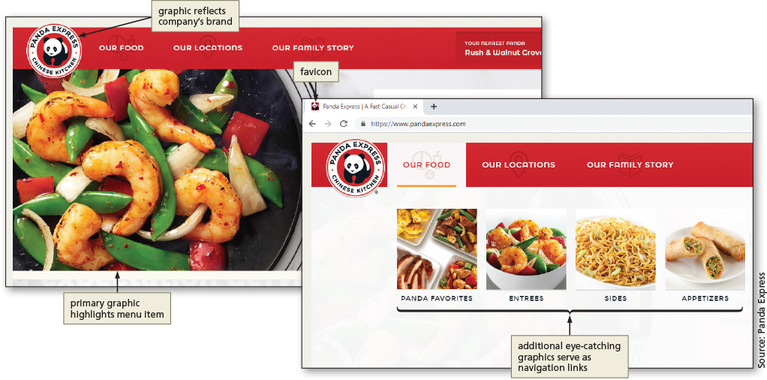
Graphics
Graphics add visual appeal to a webpage and enhance the visitor’s perception of the products and services
Figure 1–17

Slide 33
Navigation
The navigation of a website should be clear and concise
Each webpage should have a designated navigation area with links to other pages in the site
Navigation area should be prominent and easy to use

Slide 34
Typography
The use of effective typography, or fonts and font styles, enhances the visual appeal of a website
Typography should promote the purpose and goal of the website
Different fonts evoke different feelings / meanings

Slide 35
Colour
The combination of colours contributes to the appeal and legibility of a website
Aim to strike a balance among the background colour, text colour, and the colour that represents a brand
Colours convey meanings

Slide 36
Colour
Colour | Common Meaning
Red | Love, romance, anger, energy
Blue | Trust, loyalty, integrity, honesty, dependability
Green | Freshness, friendliness, health, safety, strength
Yellow | Warmth, cheer, joy, excitement, humour
Orange | Energy, warmth, health
Brown | Nature, wholesomeness, simplicity, friendliness
Black | Elegance, tradition, sophistication, formality
White | Purity, honesty, sincerity, cleanliness
Table 1-2: Common Colour Meanings

Slide 37
Accessibility
A web designer should create pages for viewing by a diverse audience, including people with physical impairments, and global users
The World Wide Web Consortium (W3C) develops and maintains web standards, language specifications, and accessibility recommendations
Making your site accessible to visitors with specific limitations enhances your site generally
E.g., making your text “real” instead of an image of text is better for viewers with visual impairments but also for robots like Google search indexing

Slide 38
Accessibility Standards for Web Developers
According to W3C, the goal of the web is to be accessible to all people, including those with a disability that limits their ability to perform computer tasks
The Rehabilitation Act of 1973 prohibits discrimination against those with disabilities
WCAG 2.0 and 2.1 guidelines are organised under four principles
Perceivable
Operable
Understandable
Robust

Slide 39
Planning Checklist
Navigation, typography, colour, layout and accessibility are some basic design criteria to consider when developing a website
A sophisticated website requires additional design considerations and research of the business and its competition

Slide 40
Webpages are created using Hypertext Markup Language (HTML)
HTML is an authoring language used to create documents for the web
Markup language, not a programming language
Consists of a set of special instructions called elements (tags) used to define the structure and layout of content in a webpage
An HTML file is a text file

Slide 41
HTML Elements and Attributes
HTML combines tags (elements) and descriptive attributes that define how a document should appear in a web browser
HTML elements include headings, paragraphs, hyperlinks, lists, and images, have a start tag and an end tag, and follow the same rules, or syntax
HTML attributes define additional characteristics, or properties, of an element

Slide 42
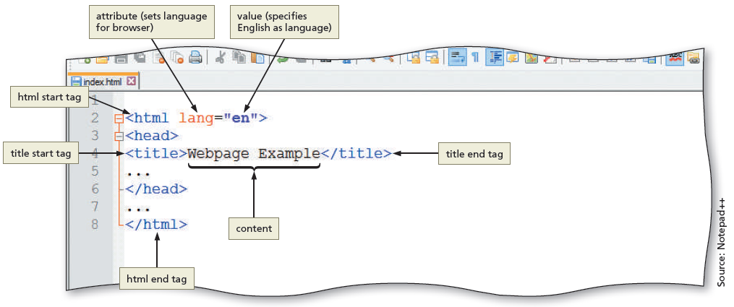
HTML Elements and Attributes
Figure 1–21

Slide 43
HTML Elements and Attributes
HTML elements are called paired tags and use the syntax: <start tag> content </end tag> which has the following meaning:
HTML elements begin with a start tag, or opening tag, such as <title>
HTML elements finish with an end tag, or closing tag, such as </title>
Content is inserted between the start and end tags
<p>This is a paragraph</p>

Slide 44
HTML Elements and Attributes
Some HTML elements are void of content
They are called empty, or void, tags
Examples of empty tags are <br> for a line break and <hr> for a horizontal line, or rule
The syntax for empty tags is <tag>

Slide 45
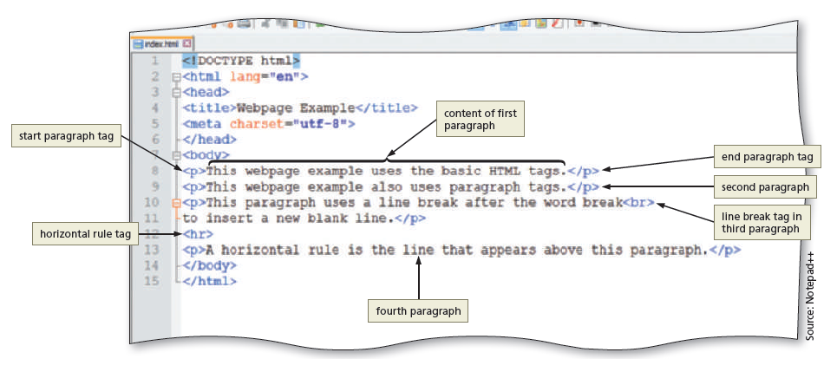
HTML Elements and Attributes
Figure 1–22

Slide 46
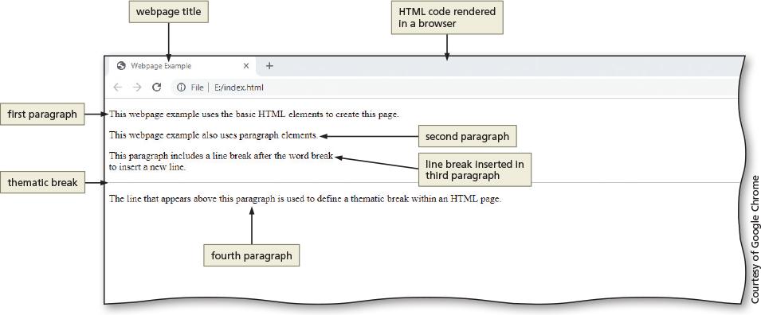
HTML Elements and Attributes
Figure 1–23

Slide 47
Technologies Related to HTML
XML: W3C introduced XML (Extensible Markup Language) in 1998 to exchange and transport data
XHTML (eXtensible Hypertext Markup Language): rewritten version of HTML using XML that was developed in 2000 and is accepted on mobile device platforms

Slide 48
HTML 5
Introduced several new elements such as header, nav, main, and footer to better define the areas of a webpage
Classified as structural elements because they define the structure of a webpage
Also known as semantic HTML elements because they provide meaning about the content of the tags

Slide 49
Understanding the Role of Other Web Programming Languages
JavaScript: popular client-side scripting language used to create interactivity within a web browser
The webpages that contain JavaScript are named with an .htm or .html extension
jQuery: library of JavaScript programs designed for easy integration onto a webpage
Makes it easy for web developers to add JavaScript to a webpage

Slide 50
Understanding the Role of Other Web Programming Languages
PHP (PHP Hypertext Preprocessor): open-source server-side scripting language used for common tasks such as writing to or querying a database located on a central server
Pages that contain PHP scripts must have file names that end with the file extension .php
ASP (Active Server Pages): server-side scripting technology
Pages that contain ASP scripts must have file names that end with the file extension .asp

Slide 51
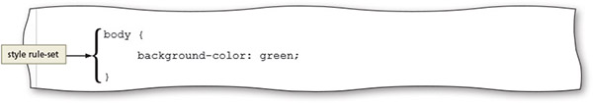
Use CSS to style your HTML/content
CSS (Cascading Style Sheets) is the language used to change how content appears
Style rules define the appearance of an HTML element
Style sheet is a set of CSS style rules
Figure 4–5

Slide 52
Separate form and function
Content & Structure = HTML
Style = CSS
Dynamic Functionality = JavaScript, PHP, DB…
These should be used appropriately
don't inextricably link content and style.
E.g. make headings headings
Top-level headings must be <h1>, content is structured correctly
Then change the style to make it look like whatever you want
… i.e. if it's too big, don't make it <h2>… that's incorrect

Slide 53
Using Web Authoring Tools
Webpages can be created using HTML with any text editor, such as Notepad++ or Visual Studio Code
A text editor program allows one to enter, change, save, and print text, which includes HTML tags
An HTML editor is a program that provides basic text-editing functions, and advanced features such as colour-coding for various HTML tags, menus to insert HTML tags, and a spelling checker
HTML is platform-independent

Slide 54
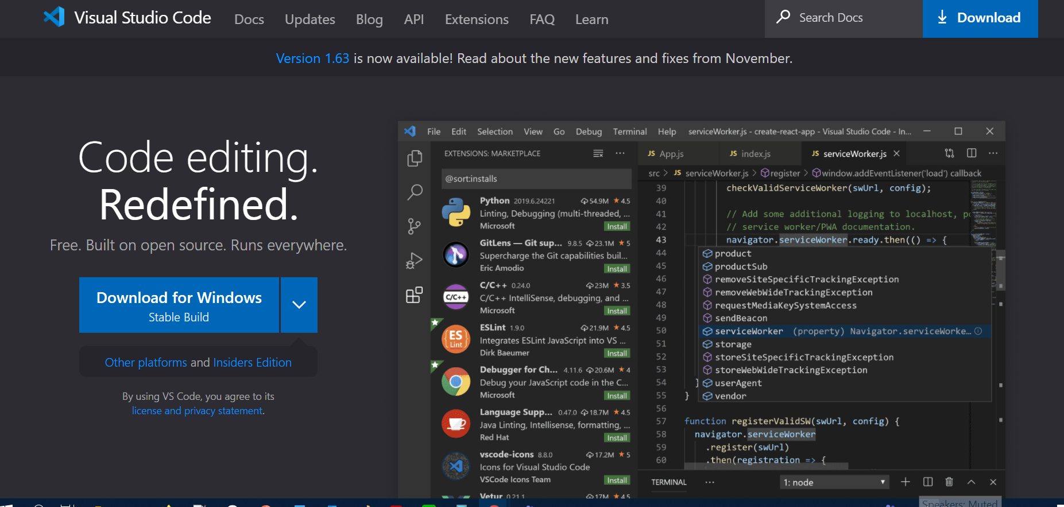
Text Editors
Notepad++ is free open-source (Windows)
Used to create files in several markup, scripting, and programming languages, including HTML, CSS, JavaScript, PHP, Java, C#, and Visual Basic
Visual Studio Code is a very popular cross-platform code editor that can be extended
Notes:
Look at https://wakatime.com/blog/51-wakatime-2021-programming-stats for some stats on editor usage (for all languages)

Slide 55
WYSIWYG and Online Code Editors
WYSIWYG editors (What You See Is What You Get)
These editors provide a graphical user interface to design a webpage
They allow users to drag HTML elements onto the page while the editor writes the code
Adobe Dreamweaver is a popular WYSIWYG editor
Online code editors
No software installation required

Slide 56
Creating a Basic Webpage
Every HTML webpage includes basic HTML tags
Refer to the text to review the steps provided:
Start your editor and create a blank document
Add basic HTML tags to a document
Add a title and text to a webpage
Save a webpage
View a webpage in a browser

Slide 57
Chapter Summary
In this chapter, you learned about:
Internet, the web, and associated technologies, including web servers and web browsers
Goal-driven websites
Planning a website
Essential roles of HTML in creating webpages and tools used to create HTML documents
How to create a basic HTML webpage

